Slide 1
Forecasting

Slide 2
Agenda
Start | End | Item
 |  | Forecasting
 |  | Method A
 |  | Method B
 |  | Method C
 |  | Workforce Planning Example

Slide 3
Main ideas
Forecast future values of a time series
Distinction between forecasting (main focus) and describing/explaining
Before forecasting understand “periodicity”
Four components of time series (meta-data):
Level
Trend
Seasonality
Noise
Time series data is great for enrichment and engineering e.g. “event flags” but can be modeled as a standalone vector due to the meta data “inside” the vector.

Slide 4
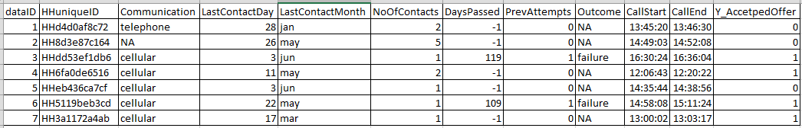
Difference between ML Data Setup & Time Series Data
ML Data Frame
Observations
Attributes for each observation
Each record is a standalone observation of a phenomena you are trying to predict, classify or cluster.
Records have defined attributes for each data row.
Notice time is not interacting between rows (or it had not better be) but is present at the observational row.

Slide 5
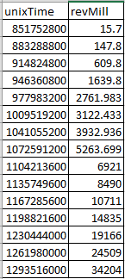
Difference between ML Data Setup & Time Series Data
Time Series Data
Data is typically (not always) in a single vector with each value being in sequence to the next.
Attributes may not be present because temporal information is held “within” the vector due to the relatedness of each record.
Observations
Attribute

Slide 6
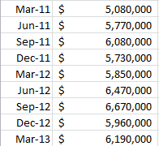
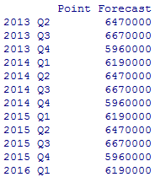

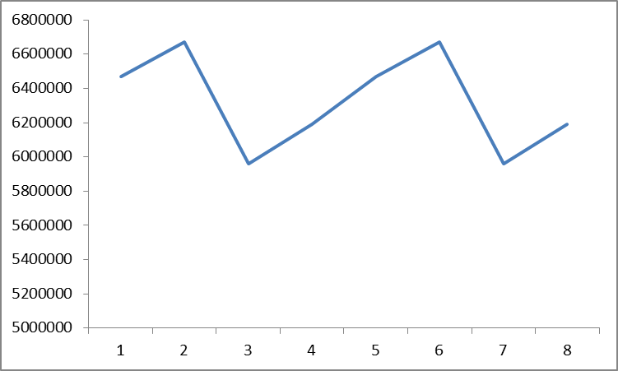
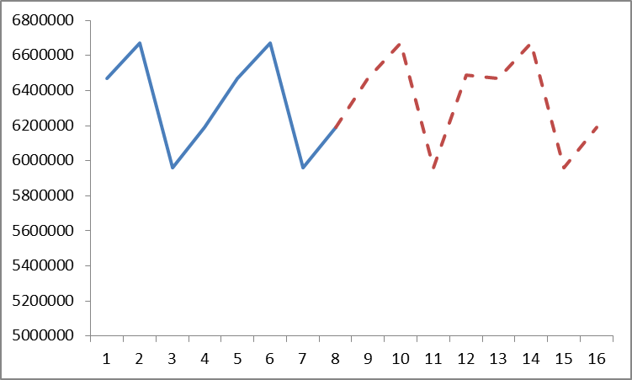
What is forecasting?
Forecasting is the process of applying mathematical tools on time series data to create future time series values, doesn’t have to explain the reason for observed changes.
Actual Time Series
Future Forecasted Values
Times Series Data > Forecast Methodology> Future Values

Slide 7
Explain Vs. Predict
Explanation is the goal of “time series analysis”
Models are based on causal argument
Models are not “black-box”
Example Explanations:
“The housing crisis reduced the expected bank revenue over a 2yr period”
“Inclement weather negatively affected holiday shopping at Target.”
Forecasting (our focus) seeks to predict future values
Example outcomes:
“Next quarter bank revenue is forecasted to rise to $XYZ”
“Wal-Mart’s 3rd quarter revenue will be $130B.”

Slide 8
The data inside the time series data
Level – an average of the observations “steady state”
Trend – are values increasing, decreasing or stationary
Seasonality – is there a repeating pattern in the periodicity
Noise – unexplained values or “residuals” from adding “trend”, “seasonality” and “level” together. Basically its what left, and unaccounted for.

Slide 9
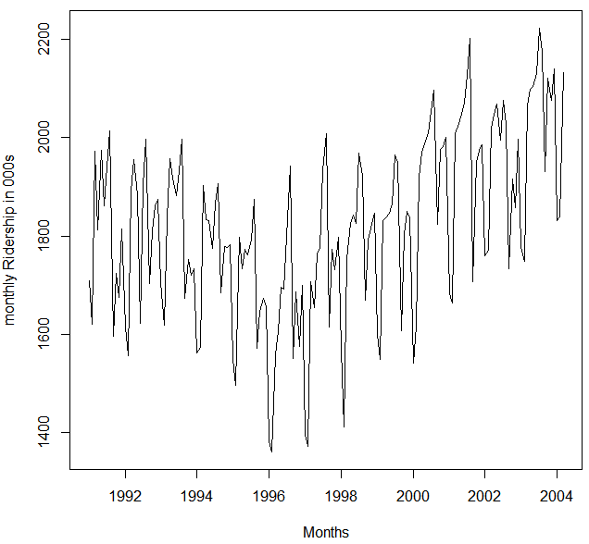

Amtrak Actual Riders
What do we observe?
Level?
Trend?
Seasonality?
Noise?

Slide 10

Monthly Amtrak Ridership
Level - about 1,800,000 passengers per month
Appears to have U-shaped trend

Slide 11
Amtrak Actuals
What do we observe?
Level?
Trend?
Seasonality?
Noise?

Slide 12
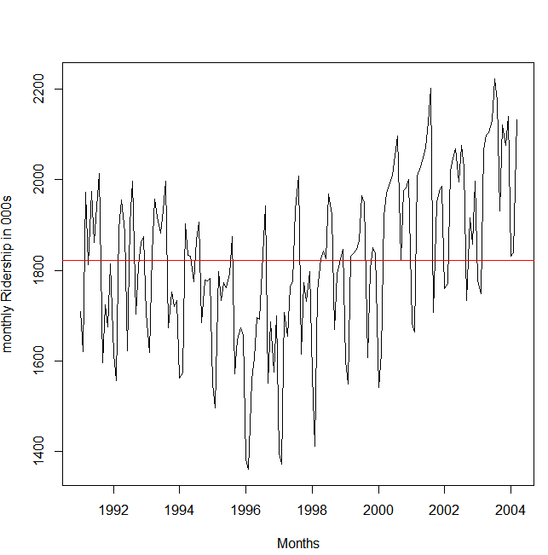
Amtrak Actuals
What do we observe?
Level?
Trend?
Seasonality?
Noise?

Slide 13
Amtrak Actuals
What do we observe?
Level?
Trend?
Seasonality?
Noise?

Slide 14
Zoom to 3 years (1997-1999)
Seasonality* appears:
Each year traffic peaks in summer
Noise:
Departure from the general level that is neither trend nor seasonality
Put another way, if you add the seasonal, trend and level values, the difference is the “noise”
* Don’t confuse the time series term “season,” which is the period over which a cyclical pattern repeats (e.g. a year), with the standard English seasons of the year (fall, winter, etc.)

Slide 15
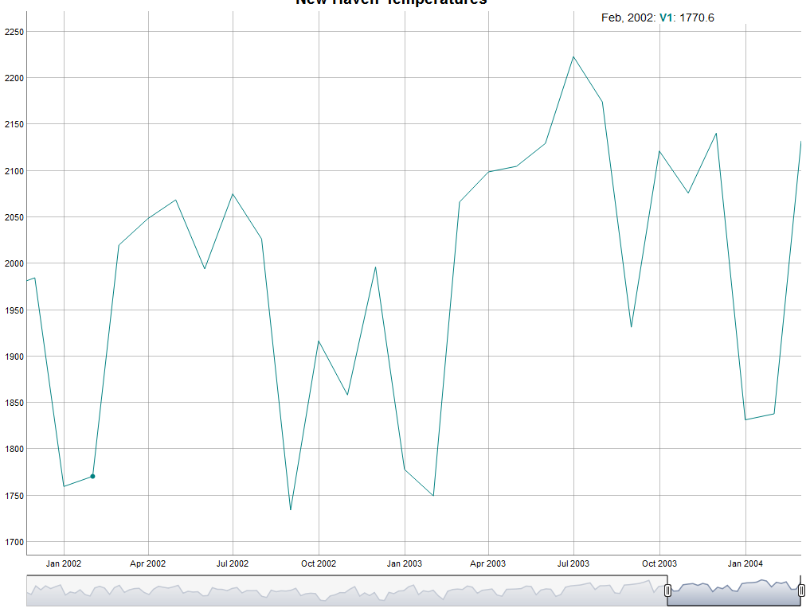
Zoom to 3 years (1997-1999)
Decline in Jan/Feb
Increase in Mar
Sustained increase until Aug

Slide 16
Open 1_amtrak.R

Slide 17
Machine Learning Partitioning
Divide data into training portion and validation portion
Test model on the validation portion
Training Data
All Data
Test Data

Slide 18
Time Series Partitioning is not random
Random partitioning would leave holes in the data, which causes problems
Forecasting methods assume regular sequential data
Instead of random selection, divide data into two parts
Train on early data
Validate on later data
Performance can be assessed against the “naïve benchmark” & historical accuracy naïve forecast is simply the most recent value in the time series
Temporal Data Points
Training Data
Validation
Sub-setting data with regard to time is called “out of time” sampling.

Slide 19
Summary
Focus is to predict (not describe/explain)
Four components
Level
Trend
Seasonality
Noise
Partition data by dividing into early/late

Slide 20
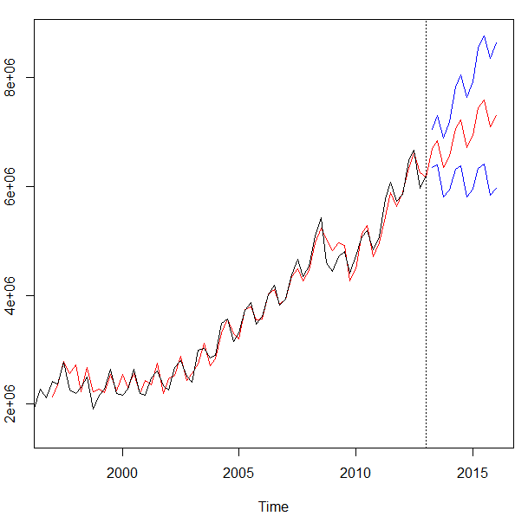
What types of business problems can be forecasted?
We will cover a set of common forecasting tools to make predictions. The goal is to create accurate future values and provide ranges of accuracy in real contexts.
Amazon’s Quarterly Revenue
Black is the actual through 2013
Red is the fit and after the dateline, the best fit-forecast.
Blue represents confidence intervals

Slide 21
What types of business problems can be forecasted?
Besides revenue, where else would a forecast benefit a company?
Forecasting has become more widespread in business.
Supply management
Sales
Product life cycles
Call centers
…

Slide 22
Open 1_getRevenueData.R
Let’s grab a time series

Slide 23
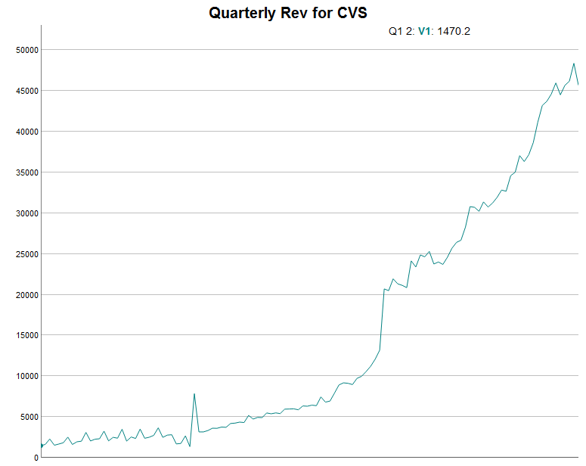
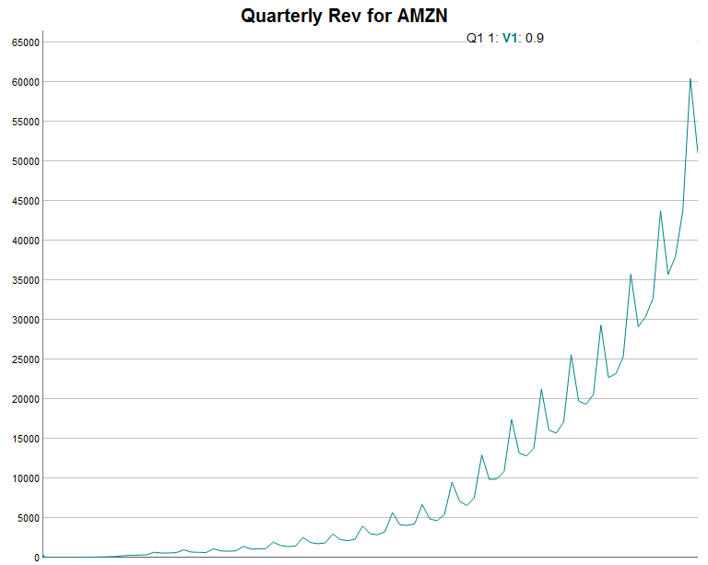
Inspecting meta data.
Based on the stock you chose, what meta data did you observe?
Trend? Level? Seasonal or seemingly random noise?
Forecasting starts with using visualizing to understand “metadata”.
*In many instances we do not know the causal inputs or have data readily available to explain what we observe.

Slide 24
Inspecting meta data.
What is the meta data for CVS?
Does the meta data exhibit a discernable pattern?
Do you think historical values are a basis for future values?

Slide 25
Inspecting meta data.
What is the meta data for AMZN?
Does the meta data exhibit a discernable pattern?
Do you think historical values are a basis for future values?

Slide 26
Agenda
Start | End | Item
 |  | Forecasting
 |  | Break
 |  | Naïve Forecasting
 |  | Time Series Decomposition
 |  | Break
 |  | Workforce Planning Example

Slide 27
5 Common Methods
We will cover 5 common methods to forecasting.
Naive
Holt Winters
TSD
ARIMA
Linear Modeling
Most common
Easy/Fast
Usually not very accurate
Exponential Smoothing
Good w/Seasonality
Decomposes into meta-data components
Good for de-seasoning & investigating
Not really forecasting future
Accurate
Good with trends/trend reversals
Good with noisy series
Good w/Seasonality
”black box”
Essentially linear regression
Requires additional data manipulation & effort

Slide 28
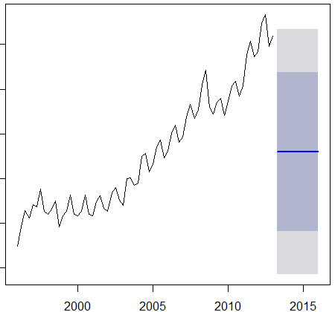
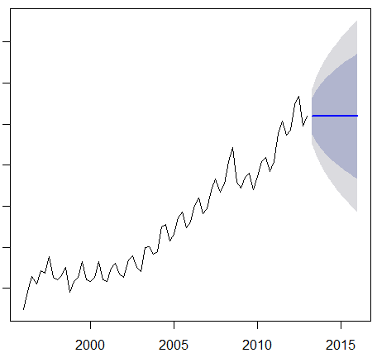
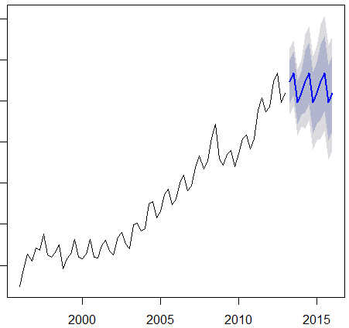
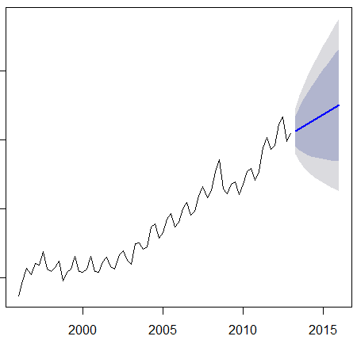
4 Methods of Naïve Forecasting
MEAN
Naïve
Seasonal
Naïve
Drift

Slide 29
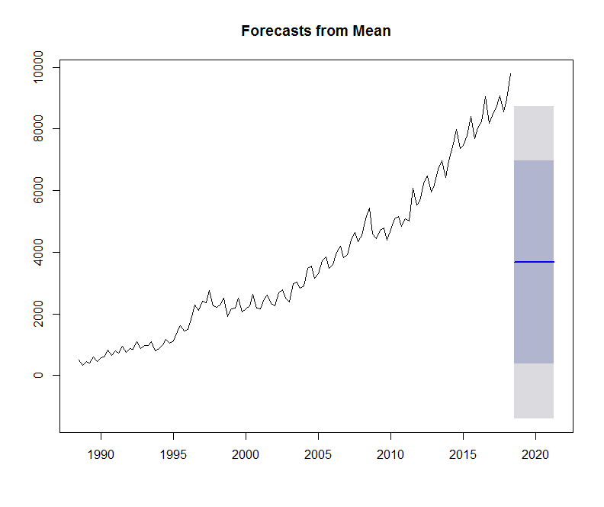
Naïve Forecast - Mean
Takes the mean for the series and repeats as future forecasts.
Does this look accurate?
When would this be appropriate?

Slide 30
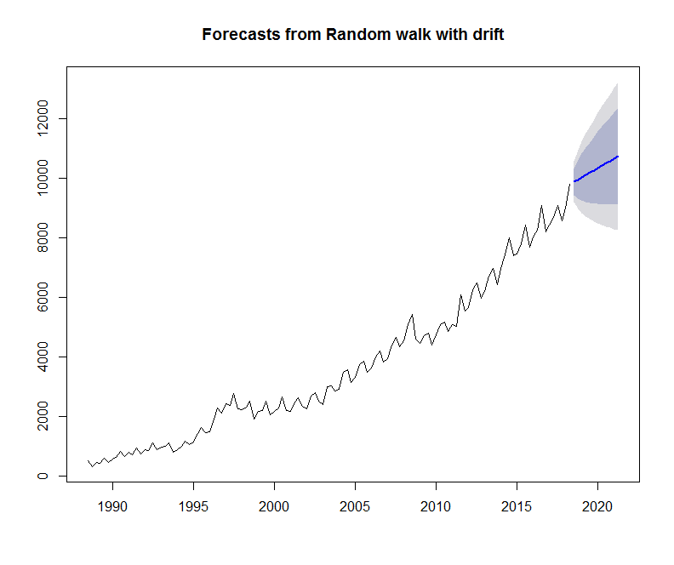
Naïve Forecast - Drift
Uses average change in data starting with last value.
Good if trend but no seasonality. Extends from last point in cycle.
Does this look accurate?
When would this be appropriate?

Slide 31
Naïve Forecast - Drift
Now notice the drift now comes from the lower point in the cycle this time.
More accurate than mean with strong trend.
Accuracy hurt by seasonality.

Slide 32
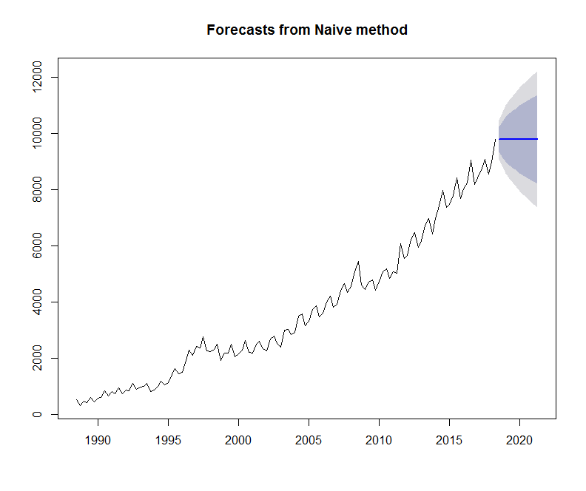
Naïve Forecast – Naïve (true)
Uses last value as future.
Does this look accurate?
When would this be appropriate?

Slide 33
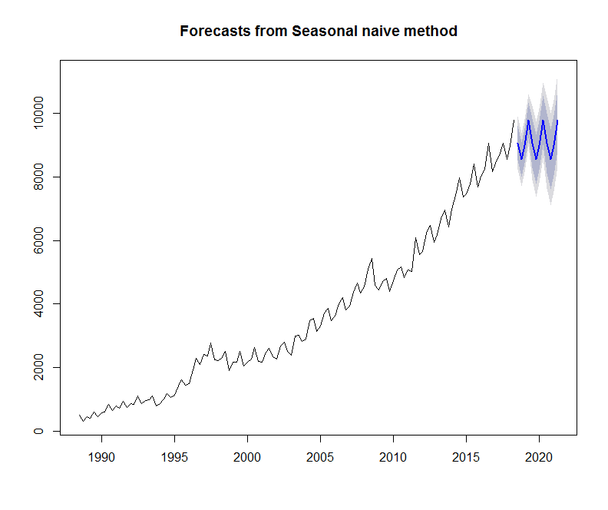
Naïve Forecast – Naïve Seasonal
Uses last corresponding seasonal values in a repeating pattern. Good if no trend.
Does this look accurate?
When would this be appropriate?

Slide 34
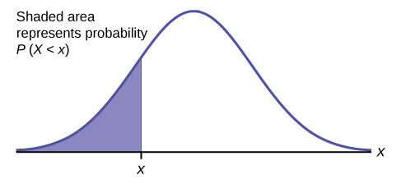
Shaded Forecast Area?
Independent and identically distributed random variables
Represents Prediction Intervals
Assumes a normal distribution
Lo 80
Hi 80
Lo 95
Hi 95
Each period increases standard deviation; stretching out the normal distribution.
As time progresses uncertainty increases
Mu:
Avg of population
Frequency
Values

Slide 35
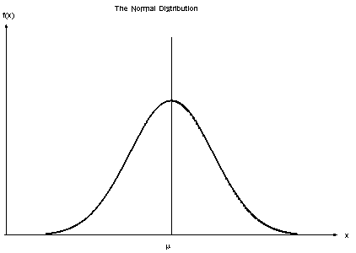
Shaded Forecast Area?
Laying the normal distribution onto the forecast you get a probability centered at the forecast.
Lo 80
Hi 80
Lo 95
Hi 95

Slide 36
Shaded Forecast Area?
The distribution advances to the next forecast to make the new prediction intervals
Lo 80
Hi 80
Lo 95
Hi 95

Slide 37
Open 2_NaiveNike.R

Slide 38
Agenda
Start | End | Item
 |  | Forecasting
 |  | Break
 |  | Naïve Forecasting
 |  | Time Series Decomposition
 |  | Break
 |  | Workforce Planning Example

Slide 39
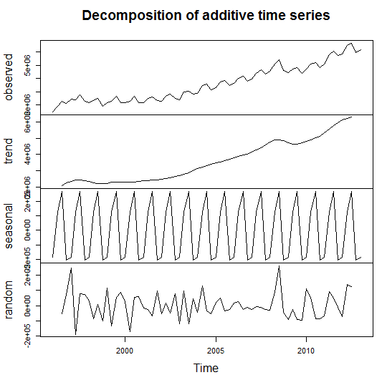
Time Series Decomposition
Decompose a time series into
Trend
Seasonal
Random (noise)
De-Season Data
Helps understand the underlying characteristics of a time series
Sometimes applying a forecast or model to the random component can improve accuracy

Slide 40
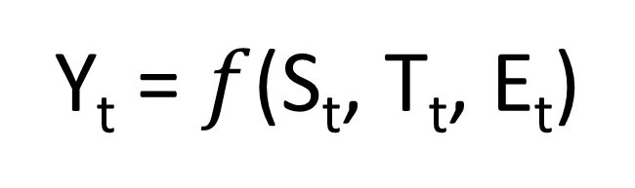
Time Series Decomposition
Y_{t} = $f$(S_{t}, T_{t}, E_{t})
Data at a specific time period (t) is equal to a mix* of seasonal values, trend values and whatever is left at the same time period.
Where (Math-speak version):
Y_{t} = data at period t
S_{t} = seasonal component at period t
T_{t} = trend component at period t
E_{t} = remainder or residual component at period t

Slide 41
Time Series Decomposition
Y_{t} = $f$(S_{t}, T_{t}, E_{t})
Data at a specific time period (t) is equal to a mix* of seasonal values, trend values and whatever is left at the same time period.
*Mix can either be
Additive – Y_{t}= Seasonal effect + Trend + Cyclical + Residual
An additive model assumes that the difference between each time period is approximately the same
For example, Jan trend is +100, so next Jan trend would add another +100.
Multiplicative - Y_{t}= Seasonal effect X Trend X Cyclical X Residual
A multiplicative model assumes changes are proportional and not constant.
For example Jan season is +100 as part of a 1,000 total (10%). The next Jan the total is 1500, and the seasonal adjustment would be 150 (10%).

Slide 42
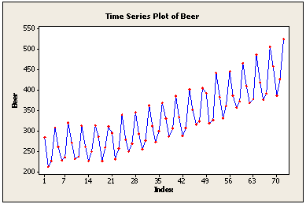
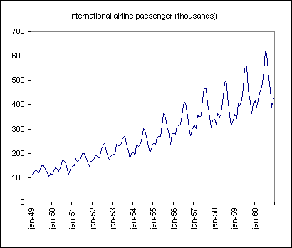
Time Series Decomposition
Additive
Multiplicative
Use additive models if the seasonality (repeating pattern) is similar.
Use multiplicative if the seasonality grows larger over time but is still the same proportion of the total

Slide 43
Seasonal Adjustment
One useful by-product from decomposition is the ability to de-season data.
Additive Seasonal Adjustment
Y_{t} - S_{t}= T_{t} + E_{t}
Multiplicative Seasonal Adjustment
Y_{t} / S_{t}= T_{t} * E_{t}

Slide 44
Summary – Time Series Decomposition
Separates Trend, Seasonal and Random components of a time series
Components are combined by
Additive – adding components is appropriate if the seasonal pattern is consistent
Multiplicative – multiplying components is appropriate if the seasonal pattern changes over time but it proportional to the time series.
TSD can help you understand the data and can be done as part of EDA
Each component can be forecasted separately to (sometimes) improve accuracy then each forecast can be combined to arrive at a final forecast
De-seasoning data is possible by subtracting (additive TSD) or dividing (multiplicative TSD) it out of the time series

Slide 45
Open 3_TimeSeriesDecompositionAMZN.R

Slide 46
Agenda
Start | End | Item
 |  | Forecasting
 |  | Break
 |  | Naïve Forecasting
 |  | Time Series Decomposition
 |  | Break
 |  | Holt Winters
 |  | Workforce Planning Example

Slide 47
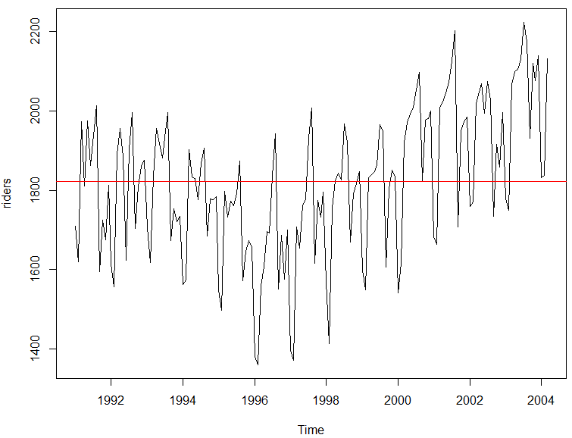
But first averages…
Mean Average – good for population summary
Add all values and divide by population
mean(riders)
[1] 1822.197
Each record has the same weight.
Number | Value
1 | 10
2 | 20
3 | 30
4 | 40
5 | 50
10+20+30+40+50
=30
5

Slide 48
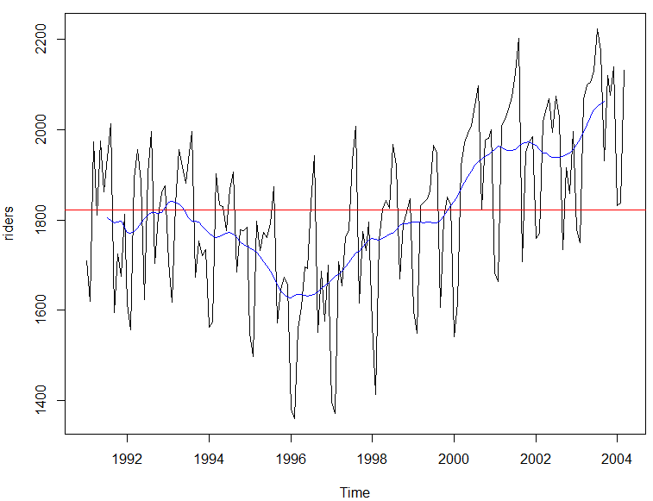
But first averages…
Centered Moving Average – smooths seasonality
Add all values and divide by population in the window
ma(riders, order =12)
Records in the window have the same weight.
Number | Value
1 | 10
2 | 20
3 | 30
4 | 40
5 | 50
t = 3
10+20+30
=15
3
…
30+40+50
=40
3
Descriptive because it uses values from the future so not good for forecasting.

Slide 49
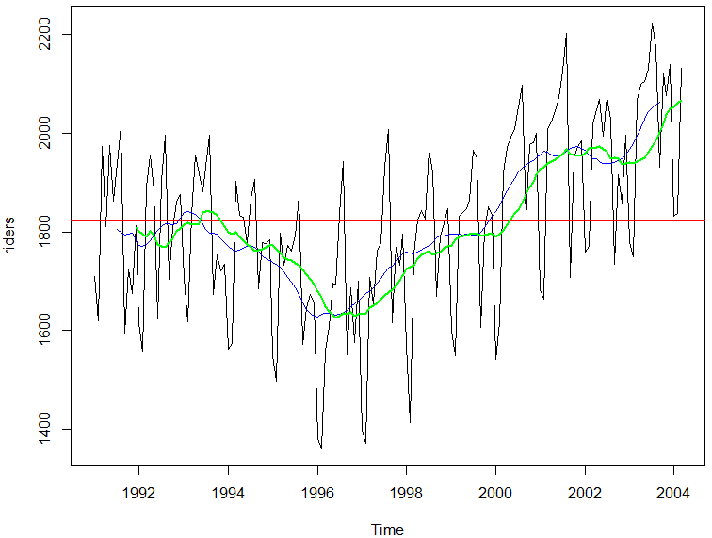
But first averages…
Trailing Moving Average – smooths seasonality
Add all values and divide by population in the window
rollmean(riders, k = 12, align = 'right'
Records in the window have the same weight.
Number | Value
1 | 10
2 | 20
3 | 30
4 | 40
5 | 50
t = 3
10+20+30
=20
3
20+30+40
=30
3
Uses preceding window values so ok for forecasts but lags for trend and seasonal.

Slide 50
But first averages…
Exponential Smoothing
Older records in the window have the diminishing weight
α is a parameter between 0 and 1.
0 = more weight is given to observations from the more distant past
Approaching 1= more weight given to recent
1 = all weight given to the most recent (same as a true Naïve forecast)
Values are weighted so their impact diminishes in the average the farther back.

Slide 51
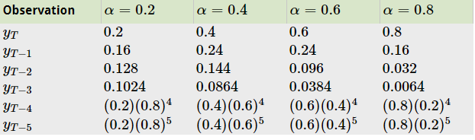
But first averages…
Exponential Smoothing – smooths seasonality
Number | Value
1 | 10
2 | 20
3 | 30
4 | 40
5 | 50
https://www.otexts.org/fpp/7/1
As a forecasting method, ONLY use if no trend or seasonality…you can use it
on the de-seasoned data.

Slide 52
But first averages…
Exponential Smoothing – smooths seasonality
Number | Value
1 | 10
2 | 20
3 | 30
4 | 40
5 | 50
Value | alpha 0.2 | Result
10 | .2*(1-.2)^4 | 0.8192
20 | .2*(1-.2)^3 | 2.0480
30 | .2*(1-.2)^2 | 3.8400
40 | .2*(1-.2) | 6.4000
50 | 0.2 | 10.0000
As a forecasting method, ONLY use if no trend or seasonality…you can use it
on the de-seasoned data.

Slide 53
Holt Winters
HW applies exponential smoothing to level, trend and seasonality individually then combines them.

Slide 54
Review: Two Popular Forecast KPIs
RMSE- Root Mean Squared Error
MAPE- Mean Absolute Percentage Error
Actual Values | Predicted/Forecasted
10 | 6
12 | 8
20 | 18
36 | 20
To manually calculate RMSE, work the acronym backwards.

Slide 55
RMSE
RMSE- Root Mean Squared Error
Actual Values | Predicted/Forecasted | Errors | Squared Errors
10 | 16 | -6 | 36
12 | 8 | 4 | 16
20 | 17 | 3 | 9
36 | 34 | 2 | 4
Mean
36+16+9+4
4
To manually calculate RMSE, work the acronym backwards.

Slide 56

RMSE
RMSE- Root Mean Squared Error
Actual Values | Predicted/Forecasted | Errors | Squared Errors
10 | 16 | -6 | 36
12 | 8 | 4 | 16
20 | 17 | 3 | 9
36 | 34 | 2 | 4
Mean
Square Root
36+16+9+4
$$\sqrt{16.25}$$
4
=4.03
In the same units being measured, tells you +/- the prediction error.

Slide 57
MAPE
MAPE- Mean Absolute Percentage Error
Actual Values | Predicted/Forecasted | Errors | Absolute | As % of Forecast
10 | 16 | -6 | 6 | =6/16 or 37%
12 | 8 | 4 | 4 | =4/8 or 50%
20 | 17 | 3 | 3 | =3/17 or 17%
36 | 34 | 2 | 2 | =2/34 or 5%
Mean of Percentages
37%+50%+17%+5%
4
=27.7%
To manually calculate RMSE, work the acronym backwards.

Slide 58
Open 4_HoltWintersWMT.R

Slide 59
Agenda
Start | End | Item
 |  | Forecasting
 |  | Method A
 |  | Method B
 |  | Method C
 |  | Workforce Planning Example

Slide 60
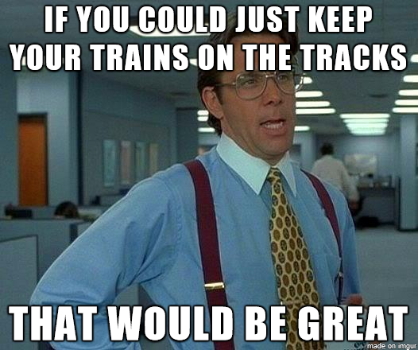
Regression Based Forecasting
Ridership Y is a function of time (t) and noise (error = e)
Y_{i} = B₀ + B₁*t + e
Thus we model 3 of the 4 components:
Level (B₀)
Trend* (B₁)
Noise (e)

Slide 61
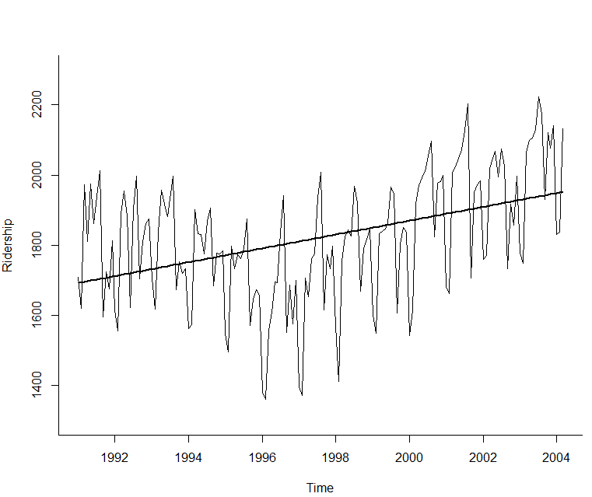
Time Series Linear Trend
# produce linear trend model
ridership.lm <- tslm(ridership.ts ~ trend)

Slide 62
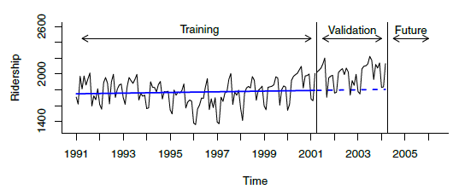
Linear Trend Predictions
train.lm.pred <- forecast(train.lm, h = nValid, level = 0)
Training Data
Validation

Slide 63
Open 5_Ch17.R

Slide 64

Exponential Trend – like amazon’s revenue
Appropriate model when increase/decrease in series over time is multiplicative
Replace Y with log(Y) then fit linear regression
log(Y_{i}) = B₀ + B₁t + e

Slide 65
Natural Logs – not to hard
“e” raised what power equals the time series value
Where “e” = ~2.718
log(2)
[1] 0.6931472
e^0.693
2.719^{(0.6931472)}
1.99
log(13)
[1] 2.564949
e^2.56949
2.719(2.56949)
13.05568
Don’t worry, R handles with the log() function.

Slide 66
Exponential trend - forecast errors
Note that performance measures in standard linear regression software are not in original units
Model forecasts will be in the form log(Y)
Return to original units by taking exponent of model forecasts
Calculate standard deviation of these forecast errors to get RMSE

Slide 67
Open 5_Ch17.R (AGAIN)

Slide 68
Other Trends Polynomial Trend
Add additional predictors as appropriate
For example, for quadratic relationship add a t² predictor
Fit linear regression using both t and t²

Slide 69
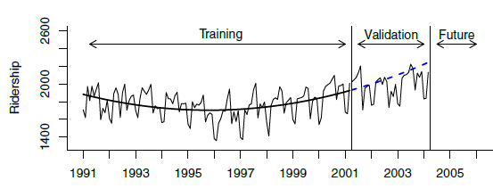
Quadratic Trend
# fit quadratic trend using function I(), which treats an # object "as is".
train.lm.poly.trend <- tslm(train.ts ~ trend + I(trend^2))
summary(train.lm.poly.trend)
train.lm.poly.trend.pred <- forecast(train.lm.poly.trend,
h = nValid, level = 0)
Due to time constraints, please review pg 408.

Slide 70
Handling Seasonality in Regression
Just make dummy variables for seasons…but beware of multi-collinearity!
Month | Ridership | Season
Jan 1991 | 1709 | Jan
Feb 1991 | 1621 | Feb
Mar 1991 | 1973 | Mar
Month | Ridership | Season | Jan | Feb | Mar | … | Nov
Jan 1991 | 1709 | Jan | 1 | 0 | 0 | … | 0
Feb 1991 | 1621 | Feb | 0 | 1 | 0 | … | 0
Mar 1991 | 1973 | Mar | 0 | 0 | 1 | … | 0
… | … | … | . | . | . | … | 1
Nov 1991 | 1675 | Nov | 0 | 0 | 0 | … | 1
Dec 1991 | 1813 | Dec | 0 | 0 | 0 | 0 | 0
To avoid multi-collinearity, there is no Dec.

Slide 71
Final model, Amtrak data
Incorporates trend and seasonality
13 predictors
11 monthly dummies
t = trends
t² = quadratic trend ( to get the positive and negative trend slopes)
train.lm.trend.season <- tslm(train.ts ~ trend +
I(trend^2) + season)

Slide 72
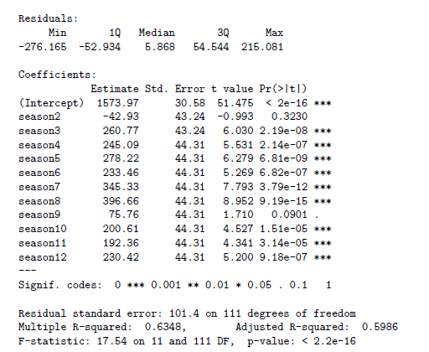
Output of full model
Due to time constraints, please review pg 410-12.

Slide 73
Regression Based Forecasting is great for events
Month | Ridership | Season | Jan | Feb | Mar | … | Nov | Summer Promo | Holiday Promo
Jan 1991 | 1709 | Jan | 1 | 0 | 0 | … | 0 | 0 | 0
Feb 1991 | 1621 | Feb | 0 | 1 | 0 | … | 0 | 0 | 0
Mar 1991 | 1973 | Mar | 0 | 0 | 1 | … | 0 | 0 | 0
… | … | … | 0 | 0 | 0 | 0 | 0 | 0 | .0
Nov 1991 | 1675 | Nov | 0 | 0 | 0 | … | 1 | 0 | 1
Dec 1991 | 1813 | Dec | 0 | 0 | 0 | 0 | 0 | 0 | 1

Slide 74
Summary – Regression Based Forecasting
Can use linear regression for exponential models (use logs) and polynomials (exponentiation)
For seasonality, use categorical variable (make dummies)
For Events, use more dummy variables
Incorporate autocorrelation by modeling it, then using those error forecasts in the main model

Slide 75
Open 6_TK_RegressionModel.R

Slide 76
Agenda
Start | End | Item
 |  | Forecasting
 |  | Method A
 |  | Method B
 |  | Method C
 |  | Workforce Planning Example

Slide 77
Autocorrelation
Unlike cross-sectional data, time-series values are typically correlated with nearby values (“autocorrelation”)
Ordinary regression does not account for this

Slide 78
Computing autocorrelation
Create “lagged” series
Copy of the original series, offset by one or more timer periods
Compute correlation between original series and lagged series
Lag-1, lag-2, etc.

Slide 79
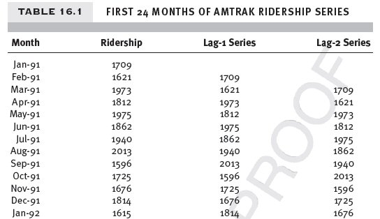
Amtrak – original series and Lag-1, Lag-2

Slide 80
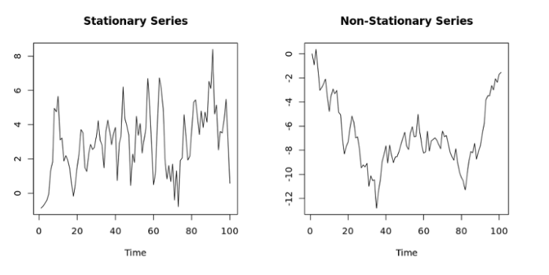
ARIMA - Stationary
Fitting an ARIMA model requires the series to be stationary. A series is said to be stationary when its mean, variance, and autocovariance are time invariant.
More simply non-stationary means the average values change through time, levels change, etc.

Slide 81
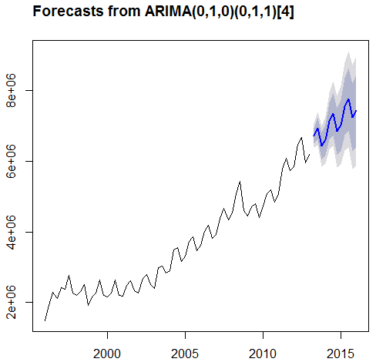
ARIMA Analogy
Arima forecasts using a combination of p, d, q inputs
p is the number of autoregressive terms,
d is the number of nonseasonal differences, and
q is the number of lagged forecast errors in the prediction equation
Good Reference:
http://people.duke.edu/~rnau/411arim.htm
As a tire rolls across a bumpy road, one can adjust the tread, air pressure, and diameter to get the smoothest ride. ARIMA adjust these inputs to get a close fit to the bumpy road. Think of these inputs as similar to the PDQ
Auto.arima() will adjust lags and p/d/q to extract more of the auto correlation (information shared between rows)

Slide 82

Before you Embark on Forecasting - Random walks
Before forecasting, consider “is the time series predictable or is it a random walk?
When we do any forecasting first try to do an AR(1) model.
Test that slope = 1 in an AR(1) model (i.e. that the forecast for a period is the most recently-observed value)
If the beta coefficient has a small p-value then the values are predictable and you should do a forecast (not a random walk)

